Slide 1

WSO2 Middleware Platform
An Introduction to the training
04/25/2016

Slide 2
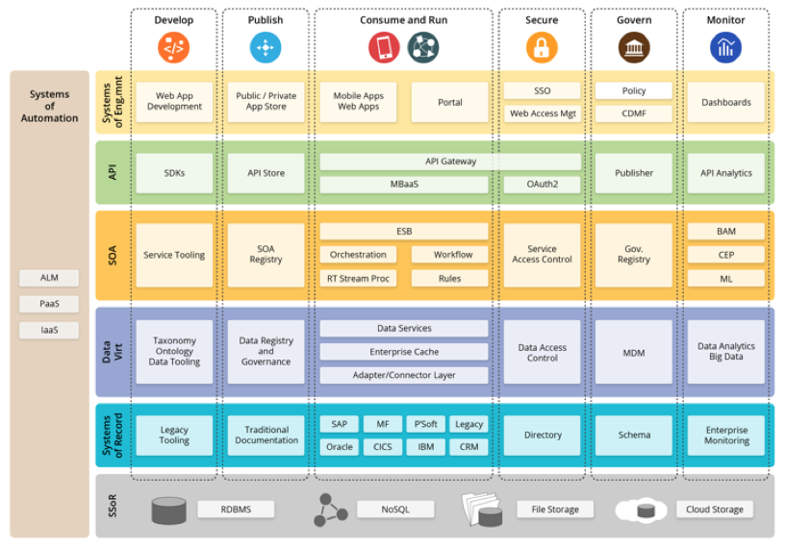
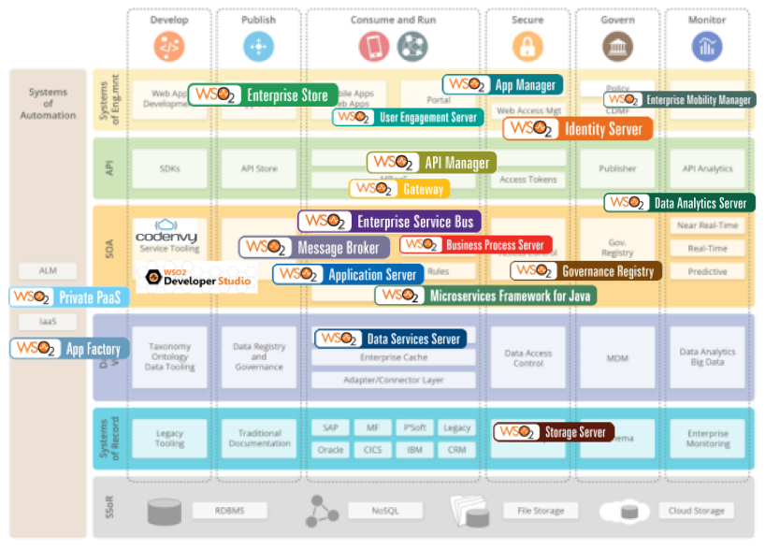
Enterprise Systems of Systems

Slide 3
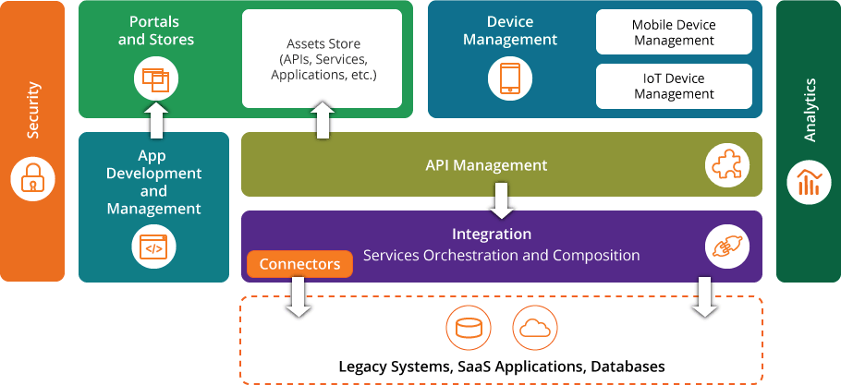
Platform in a high level

Slide 4
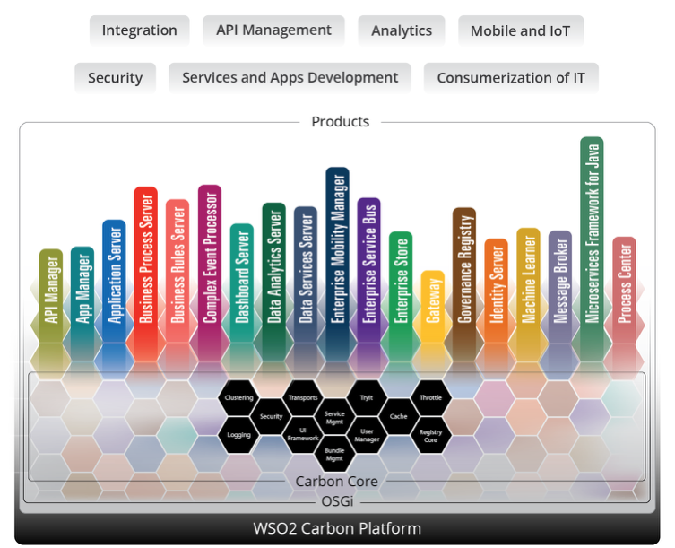
One base code many packaging

Slide 5
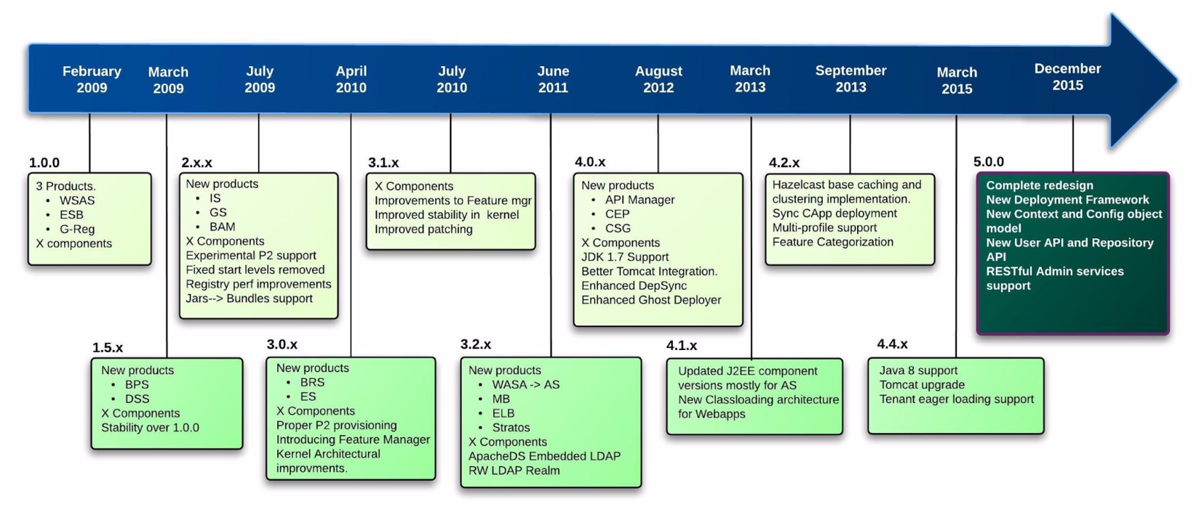
History of Carbon

Slide 6
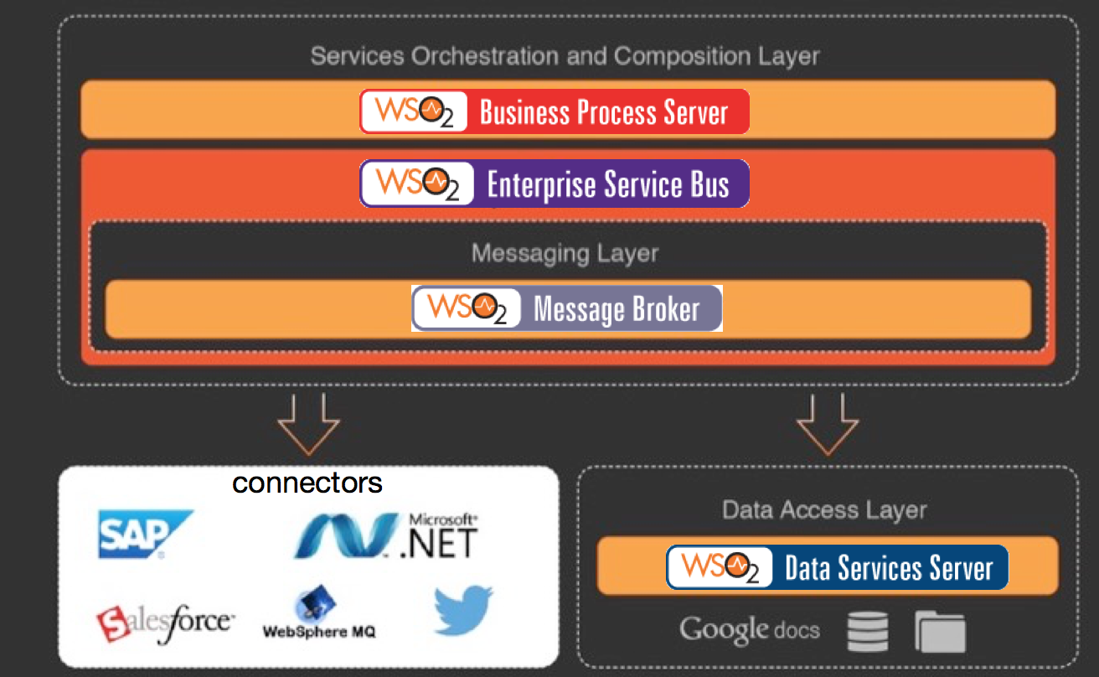
The integration Suite

Slide 7
The Integration Suite
ESB (https://docs.wso2.com/display/ESB490/Features)
Multi protocol / message format support
Extensibility (handlers, formatters, builders, mediators)
High performance
100+ cloud connectors
Message Broker (https://docs.wso2.com/display/MB310/Features)
JMS/AMQP/MQTT support
built for reliability with a highly scalable model
Analytics
Business Process Server (https://docs.wso2.com/display/BPS350/BPS+Features)
BPEL / BPEL4Humans / BPMN
Data Services Server (https://docs.wso2.com/display/DSS350/Features)
Pluggable data sources support (JDBC / Cassandra / Mongo / File etc)
Store procedure support
REST / SOAP based service composition
Data support

Slide 8
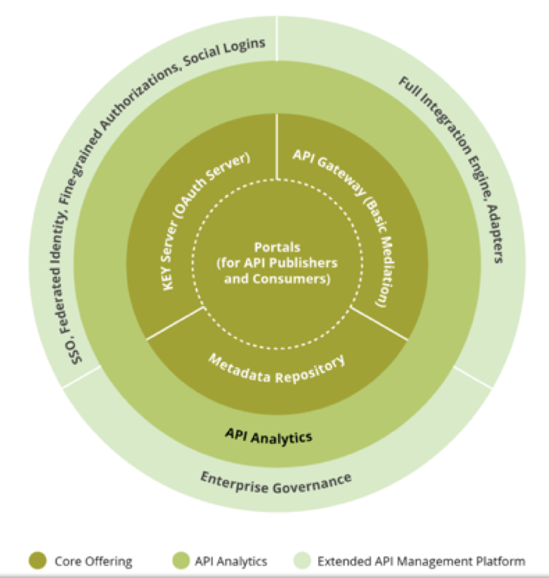
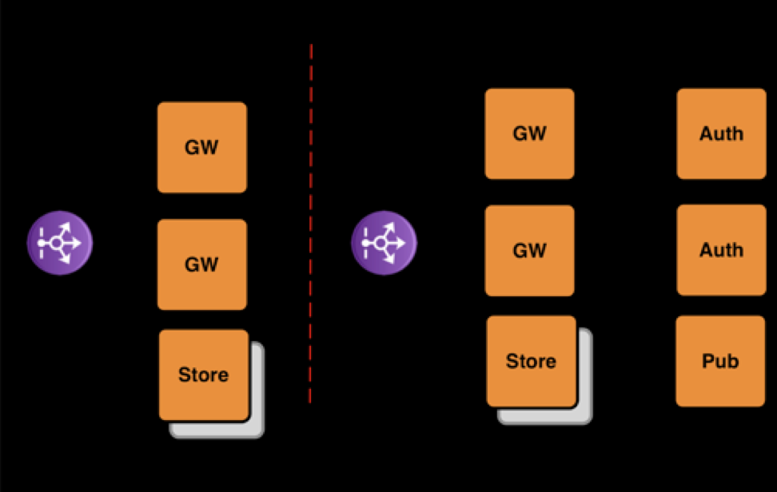
WSO2 API Manager

Slide 9
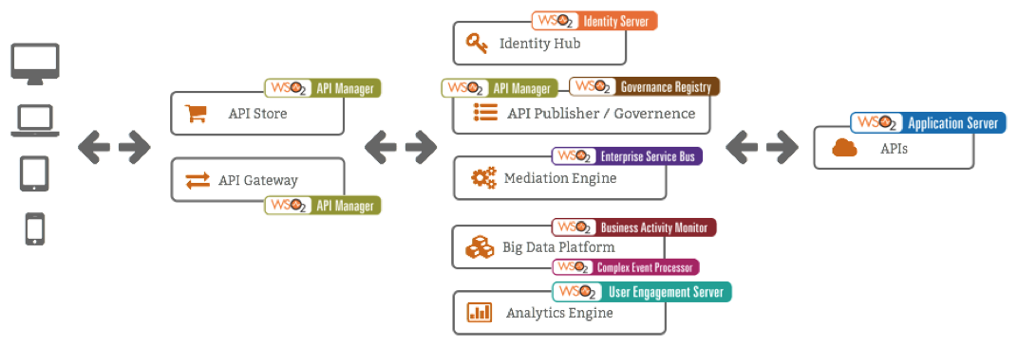
API Management Extended Architecture

Slide 10
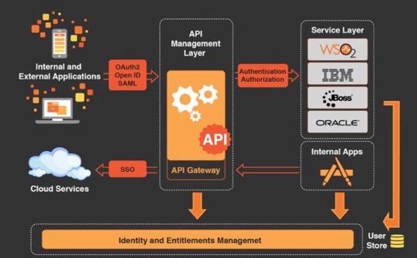
Security Platform

Slide 11
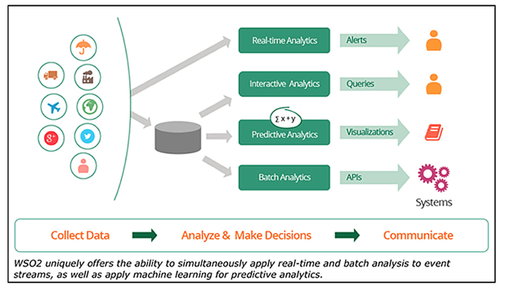
Analytics Platform

